Slide 1
CHAPTER 1
APPLICATIONS OF INTEGRATION

Slide 2
CONTENTS
1.1. More about Areas
1.2. Volumes
1.3. Arc Length
1.4. Average Value of a Function
1.5. Applications to Physics & Engineering
1.6. Applications to Economics & Biology

Slide 3
1.1 MORE ABOUT AREAS
1.1.1 Areas between Curves
1.1.2. Areas Enclosed by Parametric Curves

Slide 4
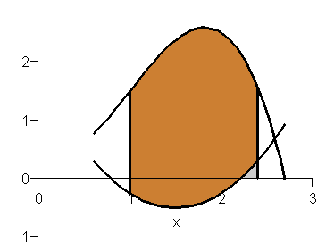
1.1.1. Areas between Curves
Consider the region S that lies between the curves y=f(x) and y=g(x) and limited by the vertical lines x = a and x = b, where f(x) and g(x) are continuous functions such that
f(x) ≥ g(x) for a ≤ x ≤ b
y=f(x)
S
a
b
y=g(x)

Slide 5
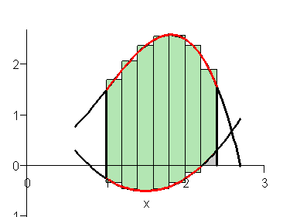
We divide S into n strips of equal width and approximate the i^{th} strip by a rectangle with base Δx and height f(x_{i}*) - g(x_{i}*). The area A of S will be approximated by the Riemann sum
Hence A may be defined as the limit of the Riemann sum
Therefore

Slide 6
Let S be the region bounded by the curves y=f(x) and y=g(x) and the lines x = a, x = b, where f and g are continuous and f(x) ≥ g(x) for a ≤ x ≤ b. Then the area A of S is
Note. In the case both f and g are positive then

Slide 7
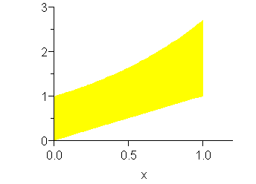
Example. Find the area of the region bounded above by y=e^{x}, bounded below by y=x, and limited by the lines x = 0 and x = 1
Solution. We have
Note. To set up an integral for the area, we graph the top and bottom curves
y=e^{x}
x=1
and a typical rectangle with area (y_{T} – y_{B})Δx.
y=x
Δx

Slide 8
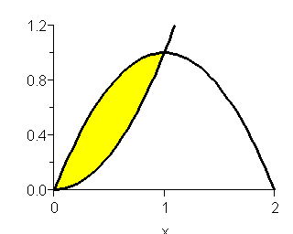
Example. Find the area of the region enclosed by the parabolas y=x² and y = 2x - x²
Solution. The x-coordinates of the intersection points of the parabolas are given by
x² = 2x - x²
i.e. 2x(x – 1) = 0
Hence x = 0 or x =1
The top and bottom curves are y = 2x - x² and y = x² The area of the typical rectangle is
(y_{T} – y_{B})Δx = (2x-x²-x²) Δx

Slide 9
Hence the total area is
Sometimes it's difficult to find the exact x-coordinates of the intersection points of the curves.
In this case we can use CAS to find the approximate values of the intersection points.

Slide 10
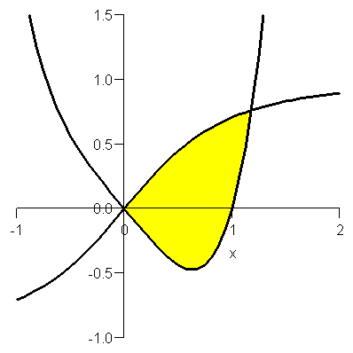
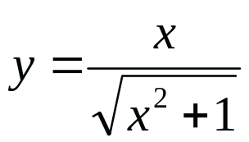
Example. Find the approximate area of the region enclosed by the curves y=x⁴ - x and
Solution. The x-coordinates of the intersection points of the curves are given by
> fsolve(x/sqrt(x^2+1)=x^4-x,x,0.1..2);
The foregoing MAPLE's command solved the equation. The result is
1.180775703
y=x⁴ - x

Slide 11
The approximate area of the region enclosed by the curves is given by
The first function is integrated by making the substitution u = x² + 1, du = 2xdx. When x=1.18 then u ≈ 2.39

Slide 12
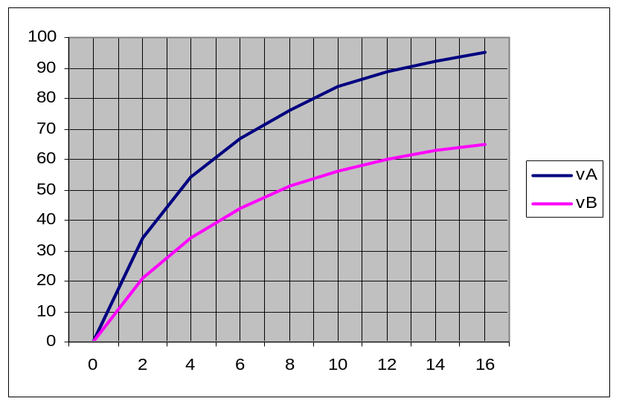
Example. Following are the velocity curves of two cars moving along the same road. What does the area between the curves represent? Using Simpson's Rule to estimate it
Solution. The area under each velocity curve is the distance travel in 16 seconds. Therefore the area between the curves represent the distance between the cars after 16 seconds
The velocities of the cars are read from the graph and converted to feet per second

Slide 13

Using Simpson's Rule with n=8, Δt =2 we can estimate the distance between the cars after 16 seconds

Slide 14
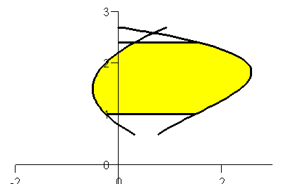
Some regions are treated as being bounded by curves with equations x=f(y) and x=g(y), y=c and y=d, where f and g are continuous functions and
f(y) ≥ g(y) for c ≤ y ≤ d
Then its area is
If we write x_{R} and x_{L} for the right and left boundary, then a typical rectangle has the dimensions x_{R} – x_{L} and Δy

Slide 15
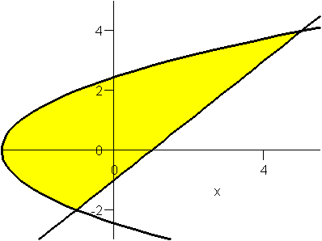


Example. Find the area of the region enclosed by the line y=x –1 and the parabola y² = 2x + 6
Solution. The intersection points are (-1,-2) and (5,4)
The equations of the left and right boundary are
The area of the typical rectangle is
(x_{R} – x_{L})Δx

Slide 16
We must integrate between the appropriate values y = -2 and y = 4
Note. We could have found the area by integrating with respect to x, but the calculation is much longer

Slide 17
1.1.2. Areas Enclosed by Parametric Curves
Recall that the areas under a curve y=F(x), F(x) ≥ 0, between a and b is
If the curve is given by the parametric equations x=f(t) and y=g(t), α ≤ t ≤ β , then we can use the Substitution Rule for Definite Integrals

Slide 18
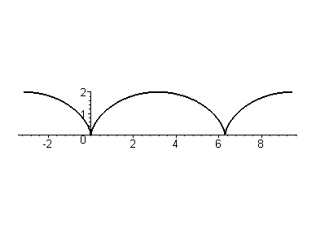
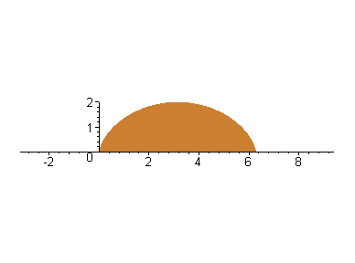
Example. Find the area under one arch of the cycloid x = r (θ –sinθ ) and y = r (1 – cosθ )
Solution. One arch of the cycloid is given by 0 ≤ θ ≤ 2π

Slide 19
Solution. Using the Substitution Rule with y = r (1 – cosθ ) and dx = r (1 – cosθ ) dθ, we have

